Slide 1
Agile Software development
Empowering Collaboration, Efficiency, and Flexibility
By Jeremy Vuong

Slide 2

Why Agile?
Welcomes changing requirements
Business personnel and developers work together
Adaptability

Slide 3

The Agile Team
The team:
Product owner (you)
Cross-functional development team
What are your roles?
Cross-functional team? What is that?

Slide 4

Team Roles and Responsibilities
You
Decide what the team will work on and when
Rank the work
Development Team
Manage the work
Do the work
Both
Communicate

Slide 5
Agile Team Qualities: Interpersonal Skills
Ability to give and receive feedback
Ability to receive and provide coaching
R-E-S-P-E-C-T
Creates a safe work environment
Promotes teamwork & collaboration

Slide 6
Agile Team Qualities: Technical Excellence
Excellence in craft
Development speed
How?

Slide 7
Valuable Meeting Culture
Planning
Progress
Retrospective

Slide 8

Agile Teams Deliver Features
What are features?
Continuous delivery
Realize value
Feedback

Slide 9

Project Management
Project manager(s)
Servant leaders
Who and what they are?
Self-aware, helpers, enablers
Represent the team
What they do
Facilitate the team’s process
Remove impediments

Slide 10
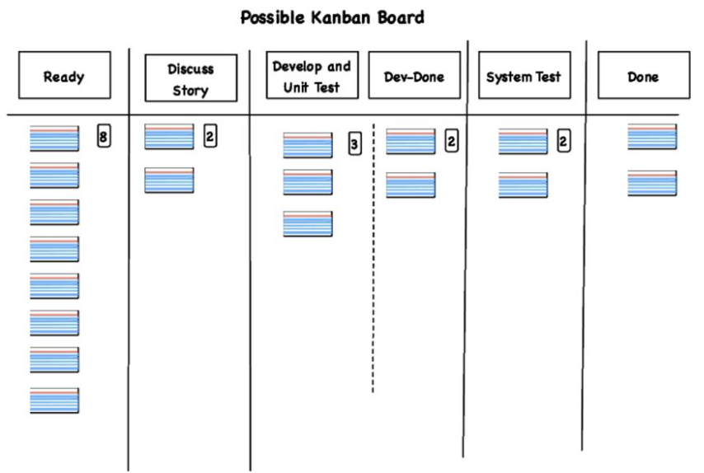
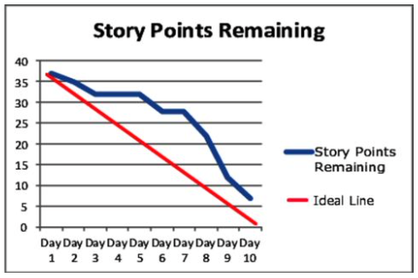
Visualization tools
Workflow boards
Scrum/Kanban boards
Manages workflow
Burndown and burnup charts
Work completed over time

Slide 11

Reporting the Project State
Visualization tools
Demonstrate working product
Meetings

Slide 12

conclusion

